Slide 1


Proposal Defence FYP I
Easy Parcel: IoT-Based Parcel Storage System for University Villages
Presented by:
Muhammad Afiq bin Zakaria
21001351
Bachelor of Computer Science (Hons)
Presented to:
Dr Siti Nurlaili Bt Karim
Ts Dr M Luqman B Mahamad Zakaria
04.07.2025 (Friday)

Slide 2

AGENDA
03
Introduction
10
Literature Review
14
Methodology
21
Conclusion & Future Works

Slide 3

INTRODUCTION

Slide 4

INTRODUCTION
UNIVERSITI TEKNOLOGI PETRONAS (UTP)
Final Year Project I
OBJECTIVES
The purpose of the project is to develop a framework, which will enhance students' skills in the process of applying knowledge, expanding thoughts, solving problems independently and presenting findings through minimum guidance and supervision.

Slide 5





INTRODUCTION
WHAT?
IMPORTANCE
Network of interconnected devices that collect, send, and receive data through the internet to automate and improve processes.
Enables automation and real-time monitoring
Increases efficiency and reduces manual work
Internet of Things (IoT)
APPLICATION
FEATURES
Smart Homes
Healthcare
Transportation
Agriculture
Logistics and Delivery
TECHNOLOGIES USED
Remote access & control
Data collection & analytics
Integration with mobile apps
Sensors & Actuators
Microcontrollers (e.g., ESP32, Raspberry Pi)
Cloud Platforms & Mobile Apps

Slide 6

BACKGROUND OF STUDY
1
Malaysia E-commerce Growth
2
University Students Role in E-commerce
E-commerce in Malaysia has seen remarkable growth in recent years
Malaysia is now one of Southeast Asia’s leading digital markets
E-commerce users projected to increase by over 75% reaching expected 18.81 million users by 2029
University students make up a large and growing portion of online shoppers
Known for high digital literacy and frequent internet and mobile usage
Prefer e-commerce for its convenience, affordability, and variety
SUMMARY
ParcelHub was introduced to manage the increasing volume of parcels received by university students.
The system supports the growing trend of online shopping among students.
ParcelHub ensures students receive their parcels safely and at a time that suits their schedule.
It aims to streamline the delivery process and reduce issues like lost or mishandled parcels.

Slide 7

PROBLEM STATEMENT
While the ParcelHub aims to simplify parcel collection, it still has notable flaws that impact student convenience.
One centralized location (ParcelHub), far from most student residences
Long queues during peak hours
Inconvenient for students without transport
Students must pay additional charges to collect parcels
Creates parking problems for those who drive

Slide 8



OBJECTIVES
To implement a random password lock system and barcode scanning for secure identification of parcel senders (couriers) and receivers (students).
To design and develop an IoT-based smart locker system for student villages to store small parcels securely
To build a mobile application for both students and couriers to manage locker access, track deliveries, and receive parcel notifications.
Notes:
This project has three main objectives:

Slide 9
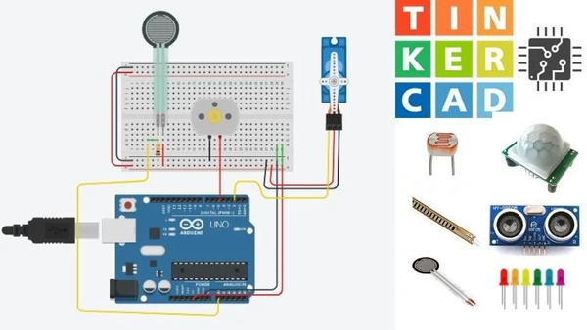


SCOPE OF STUDY
Build a smart locker prototype using Arduino, sensors, and locks.
Simulate circuit design using Tinkercad.
Connect hardware to Firebase for real-time status and access logging.
Develop a mobile app using Flutter for students and couriers to access lockers, track parcels, and receive notifications.
Data will be managed using Firebase Firestore.
Implement OTP-based access using Firebase Authentication.
Integrate barcode scanning to log parcel sender and receiver details, with records stored in the cloud.

Slide 10
LITERATURE REVIEW

Slide 11
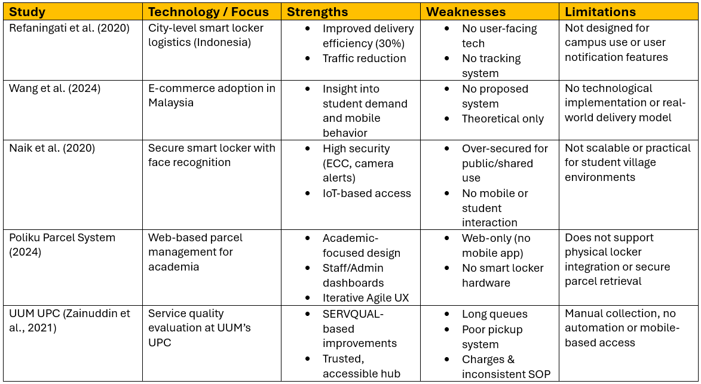
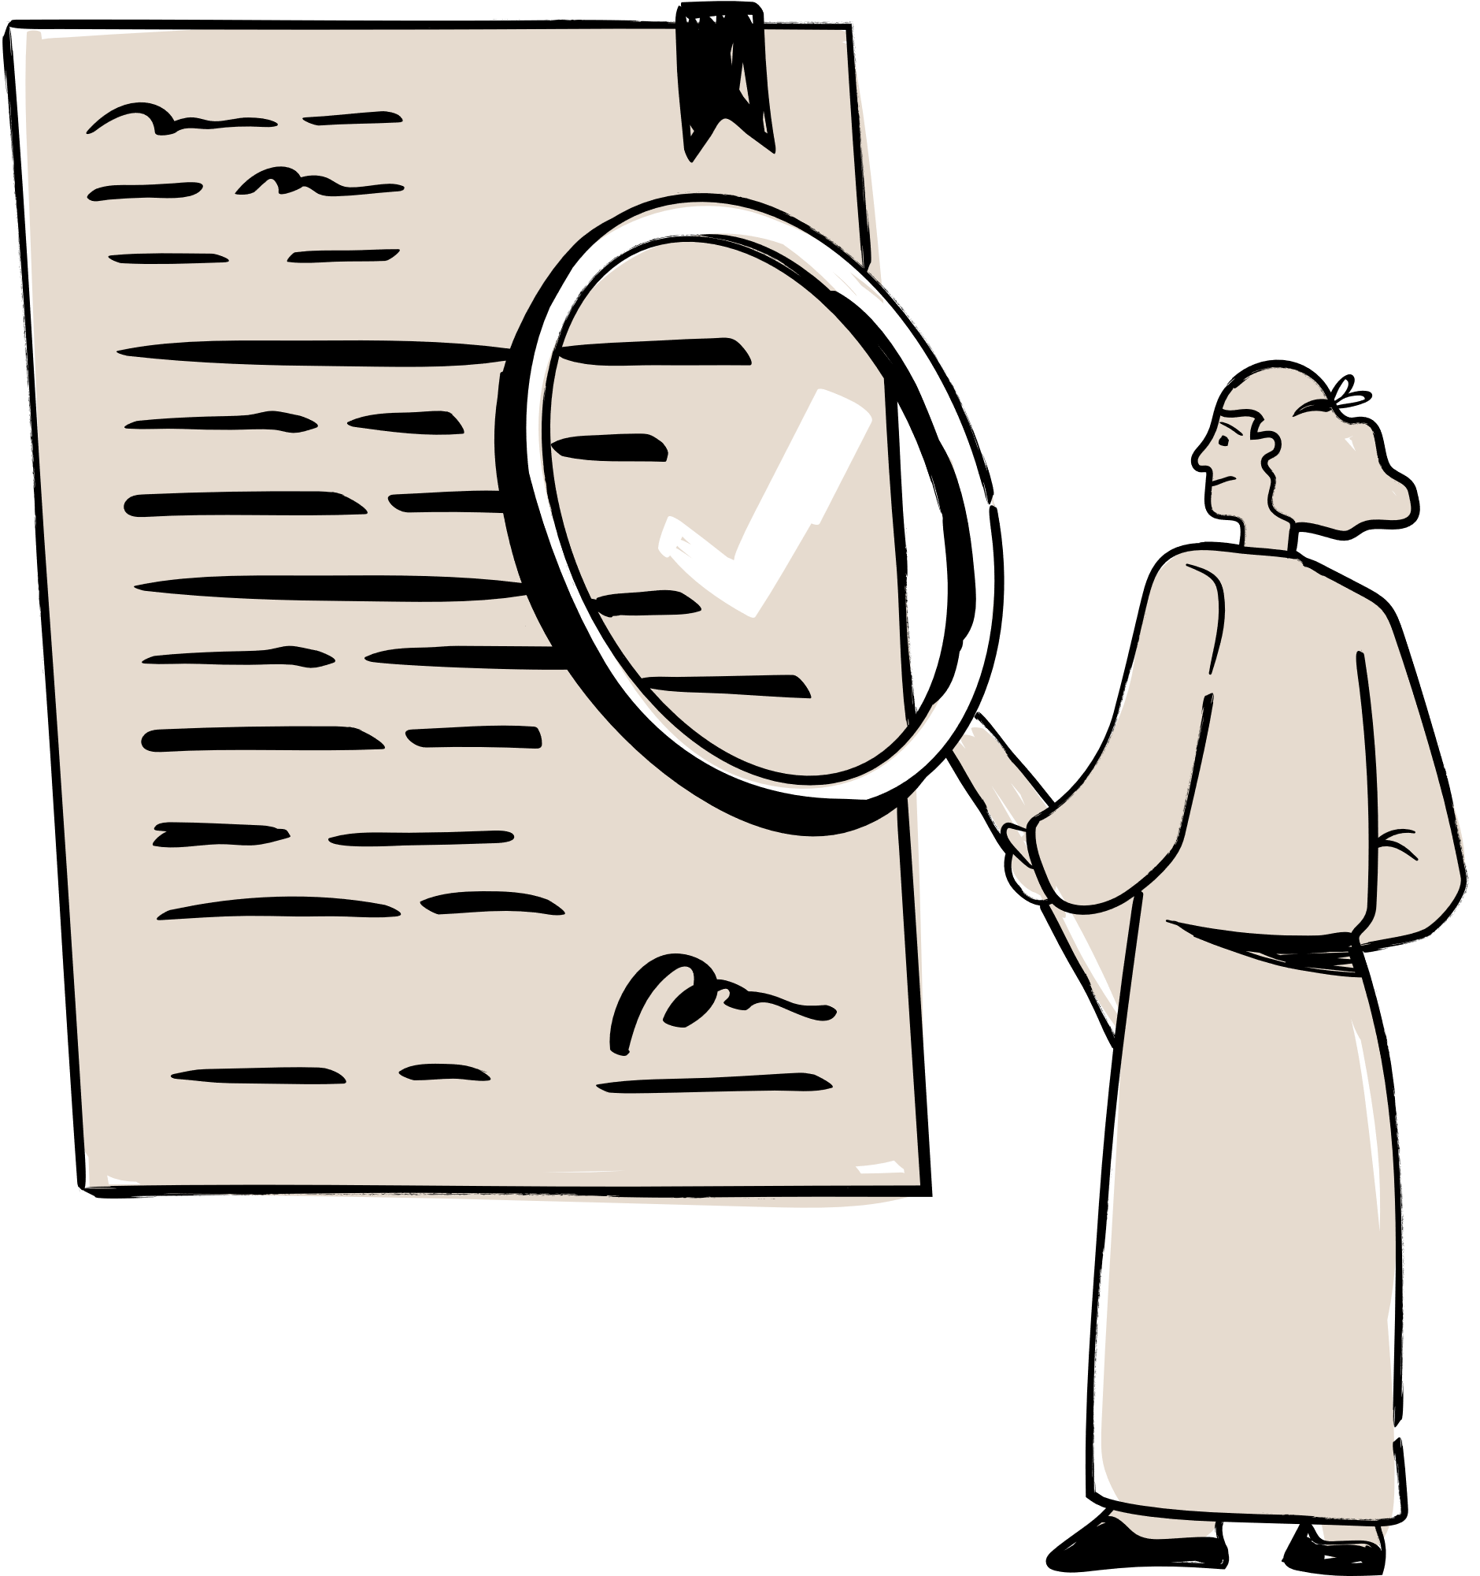

LITERATURE REVIEW
LITERATURE REVIEW - RESEARCH STUDY

Slide 12
LITERATURE REVIEW
RESEARCH GAPS
1
Lack of integrated mobile control
2
3
Student-specific design
Access & security balance
Systems like Poliku and UPC use web-based tools but don’t integrate with mobile apps or IoT hardware.
Most systems fail to balance security with usability, making them either too complex for shared campus environments or too basic to ensure parcel safety.
Most systems aren't tailored for students in residential campus settings with limited mobility.
Courier-side support
4
Affordability & Scalability
5
Existing solutions rarely include features that support courier-side access, such as barcode scanning or OTP verification for secure parcel drop-offs.
Commercial systems may be costly and hard to scale or adapt in smaller campus communities.

Slide 13
LITERATURE REVIEW
Solution of The Research Gaps - Easy Parcel
1
Lack of integrated mobile control
2
3
Student-specific design
Access & security balance
Easy Parcel is designed specifically for student residential villages, where students often lack personal transport and need accessible, on-campus parcel services
The system includes a dedicated mobile app, allowing students to receive real-time notifications, track parcels, and open lockers using OTPs
Instead of complex biometric systems, Easy Parcel uses practical OTP, offering secure access without overcomplicating the user experience
Courier-side support
4
Affordability & Scalability
5
Couriers can deliver parcels into specific lockers, reducing delivery errors and enabling secure, contactless drop-offs
The system is prototyped using Arduino for proof of concept, but designed to scale using affordable, off-the-shelf IoT components for real-world deployment in campus

Slide 14
METHODOLOGY

Slide 15
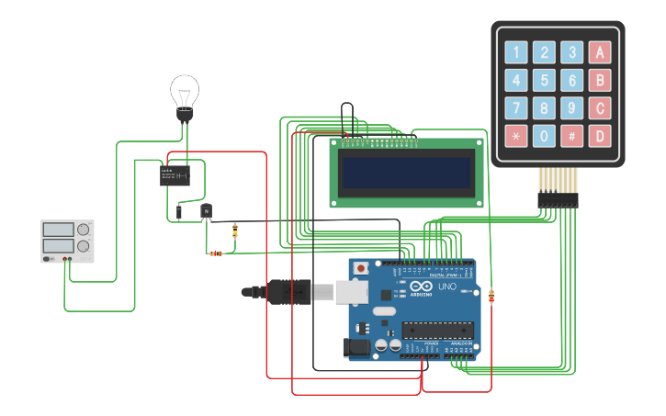
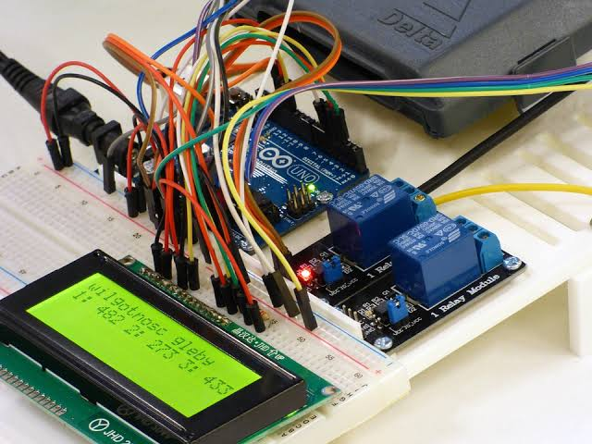
METHODOLOGY
SMART LOCKER - HARDWARE
Design & Simulation Phase
Confirm the design through Tinkercad simulation to ensure it works as intended.
Verification & Confirmation
Use Arduino Uno R3 as the main microcontroller.
Design and simulate the electronic circuit using Tinkercad.
Simulate component connections, logic flow, and system behavior in a cost-effective and safe environment.
Assemble the hardware using real components based on the validated simulation design.
Implementation & Testing
Implement the system step-by-step to ensure a smooth transition from design to prototype.Aim to minimize errors and rework during development.
Physical Assembly Phase

Slide 16

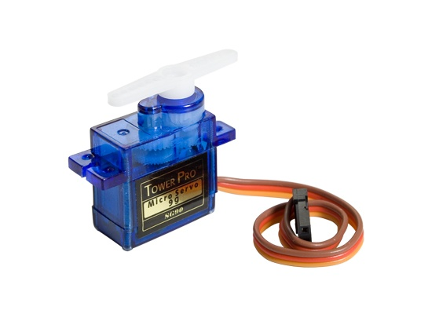
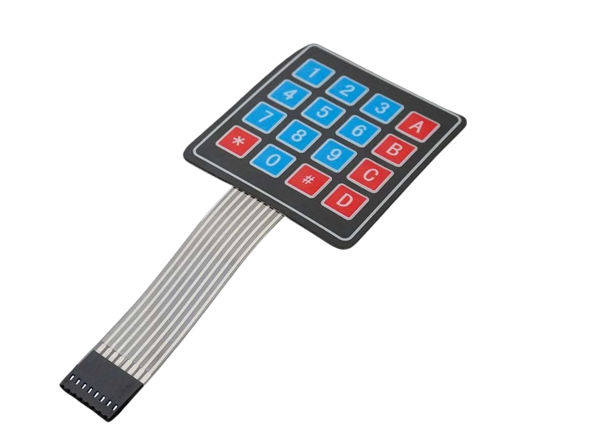
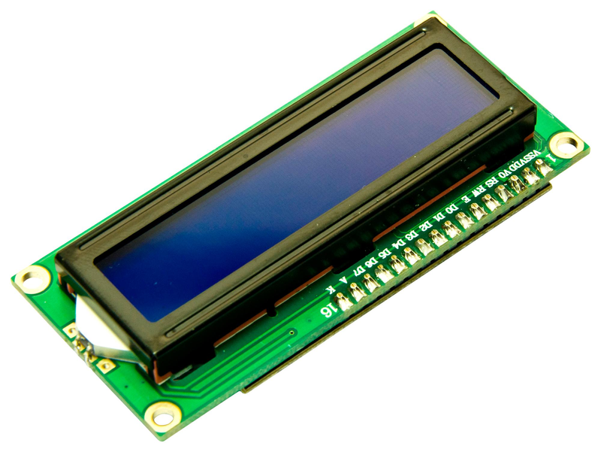
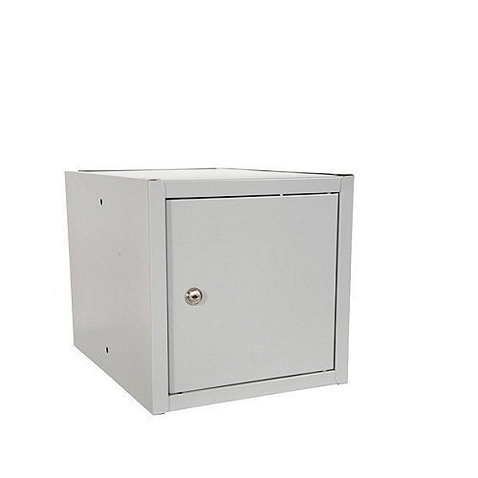
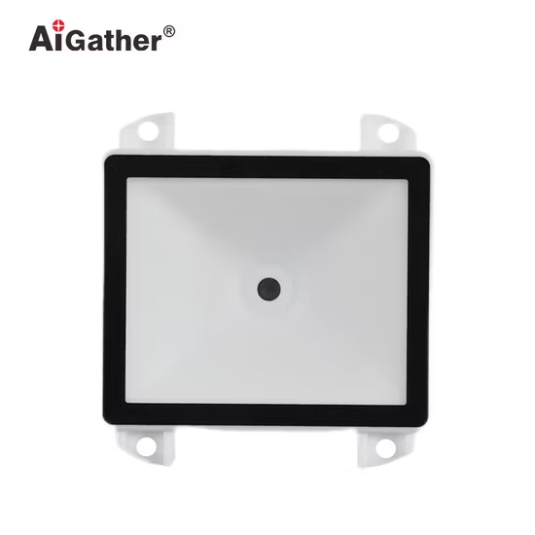
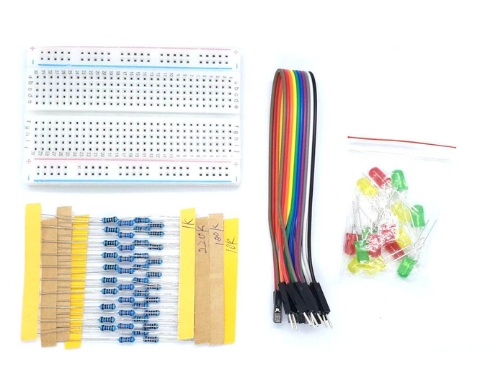
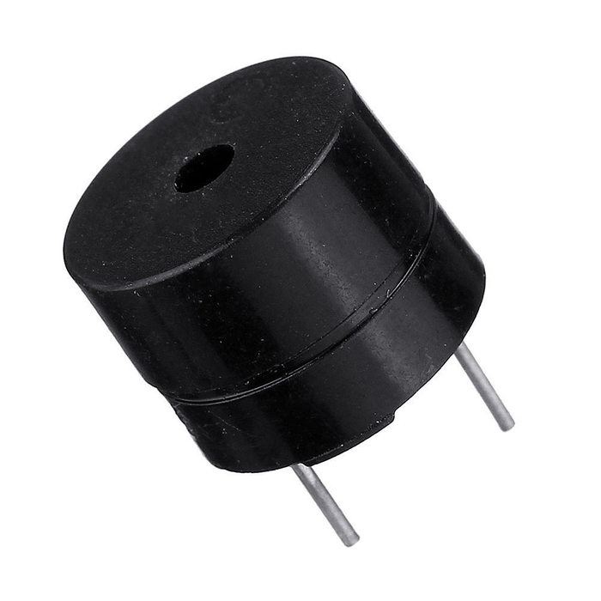
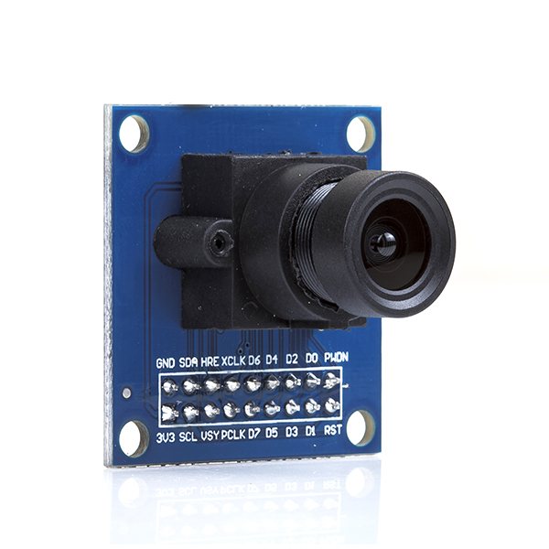
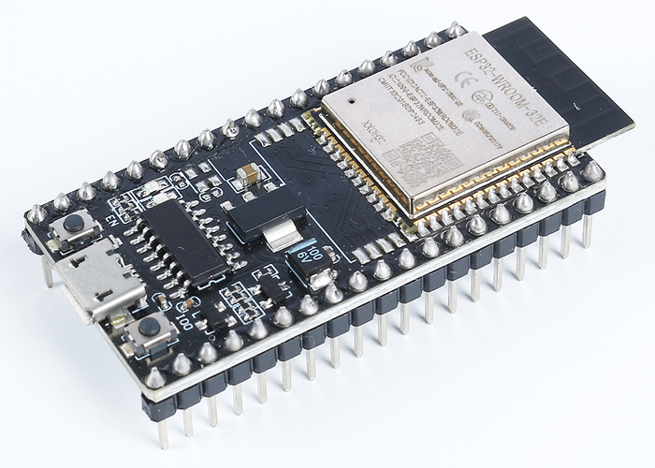
METHODOLOGY
HARDWARE COMPONENTS
1
Arduino Uno R3
2
Servo Motor
3
Keypad
4
LCD
5
Locker
Main microcontroller for controlling inputs and outputs.
To open and close the locker door electronically.
To allow manual entry of OTP or password.
To display status messages or OTP confirmations.
To house the electronics and simulate the parcel storage compartment.
Breadboard, Wires, Capasitor and LED
Barcode Scanner
Buzzer
OV7670
ESP32
6
7
8
9
10
To scan courier and parcel information.
For circuit connections and prototyping.
To provide audible feedback (e.g., when access is granted or denied).
(optional) For capturing images/videos during locker access.
(optional) To enable wireless communication with Firebase if direct integration is needed.
Notes:
These are the main components I plan to use:

Slide 17

METHODOLOGY
MOBILE APPLICATION - SOFTWARE
Development Process
App Development
UI Design
Create wireframes and user flow diagrams to outline the structure and navigation of the app.
Build the app using Dart and Flutter’s widget system for smooth, responsive interfaces.
The mobile application will be developed using Flutter, a cross-platform framework by Google that allows building Android and iOS apps from a single codebase. Flutter is chosen for its fast development, beautiful UI capabilities, and seamless integration with Firebase.
Firebase Integration
Use Firebase Authentication for OTP-based login.
Use Firestore to manage parcel and locker data.
Enable Firebase Cloud Messaging (FCM) for push notifications.
Testing
Perform functional and usability testing to ensure smooth performance across platforms.

Slide 18
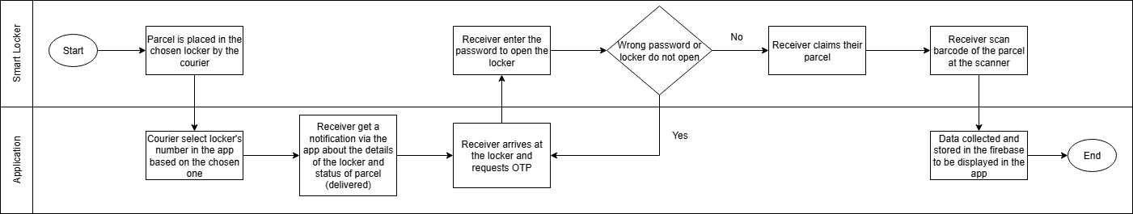
METHODOLOGY
SYSTEM ARCHITECTURE

Slide 19
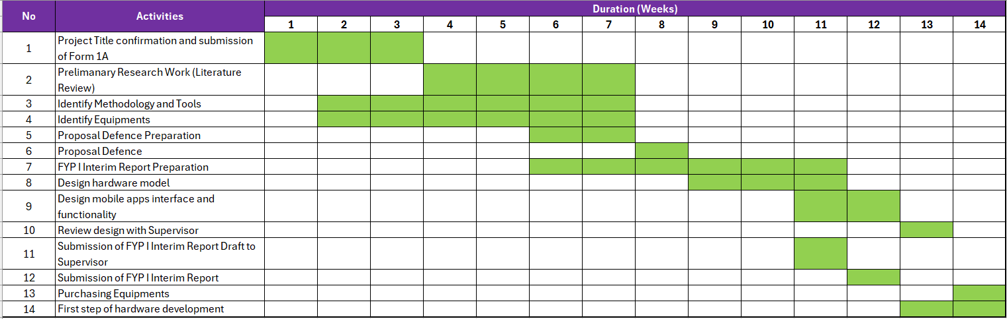
METHODOLOGY
GANNT CHART & MILESTONES - FYP I

Slide 20
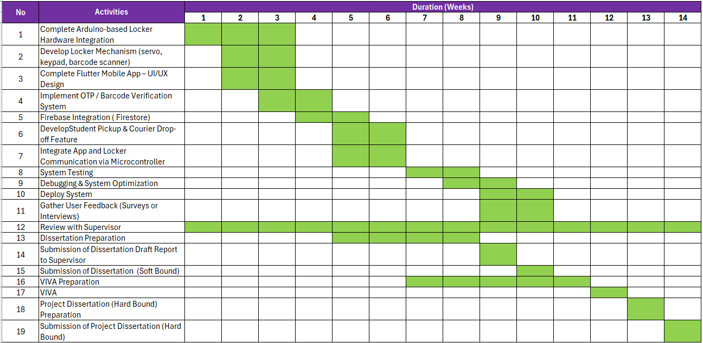
METHODOLOGY
GANNT CHART & MILESTONES - FYP II

Slide 21
METHODOLOGY
EXPECTED OUTCOME
🔒 Functional Smart Locker Prototype
A working locker system using Arduino with servo lock, keypad, and barcode scanner to simulate secure parcel storage and retrieval.
📱 Mobile Application for Students and Couriers
Flutter-based app allowing users to receive parcel notifications, track deliveries, and access lockers via OTP or barcode.
🔍 Secure Parcel Access System
Implementation of OTP and barcode scanning for authenticated courier drop-off and student pick-up.
📈 Improved Parcel Handling Experience for Students
Faster, more convenient, and more secure alternative to centralized collection points like ParcelHub.

Slide 22
CONCLUSION & FUTURE WORKS

Slide 23

CONCLUSION
This project aims to improve the parcel collection experience for students by introducing a smart, secure, and accessible locker system within residential villages. By integrating IoT hardware with a mobile app, it offers a more convenient and efficient solution compared to the current centralized ParcelHub system.

Slide 24

FUTURE WORK
Deeper Understanding of Flutter
Continue exploring advanced Flutter features to improve UI/UX, performance, and maintainability of the mobile app.
1
Enhance System Integration
Improve the integration between the mobile app and hardware components for more stable real-time communication and response.
2
To achieve all outlined objectives and complete the work within the planned timeline
Optimize Firebase Usage
Explore advanced Firebase functions like real-time syncing, cloud functions, and analytics to boost system efficiency.
3
Improve Hardware Troubleshooting Skills
Gain deeper hands-on experience with Arduino components to quickly identify, test, and resolve hardware issues during development.
4

Slide 25
THANK YOU
THANK YOU

